Slide 1
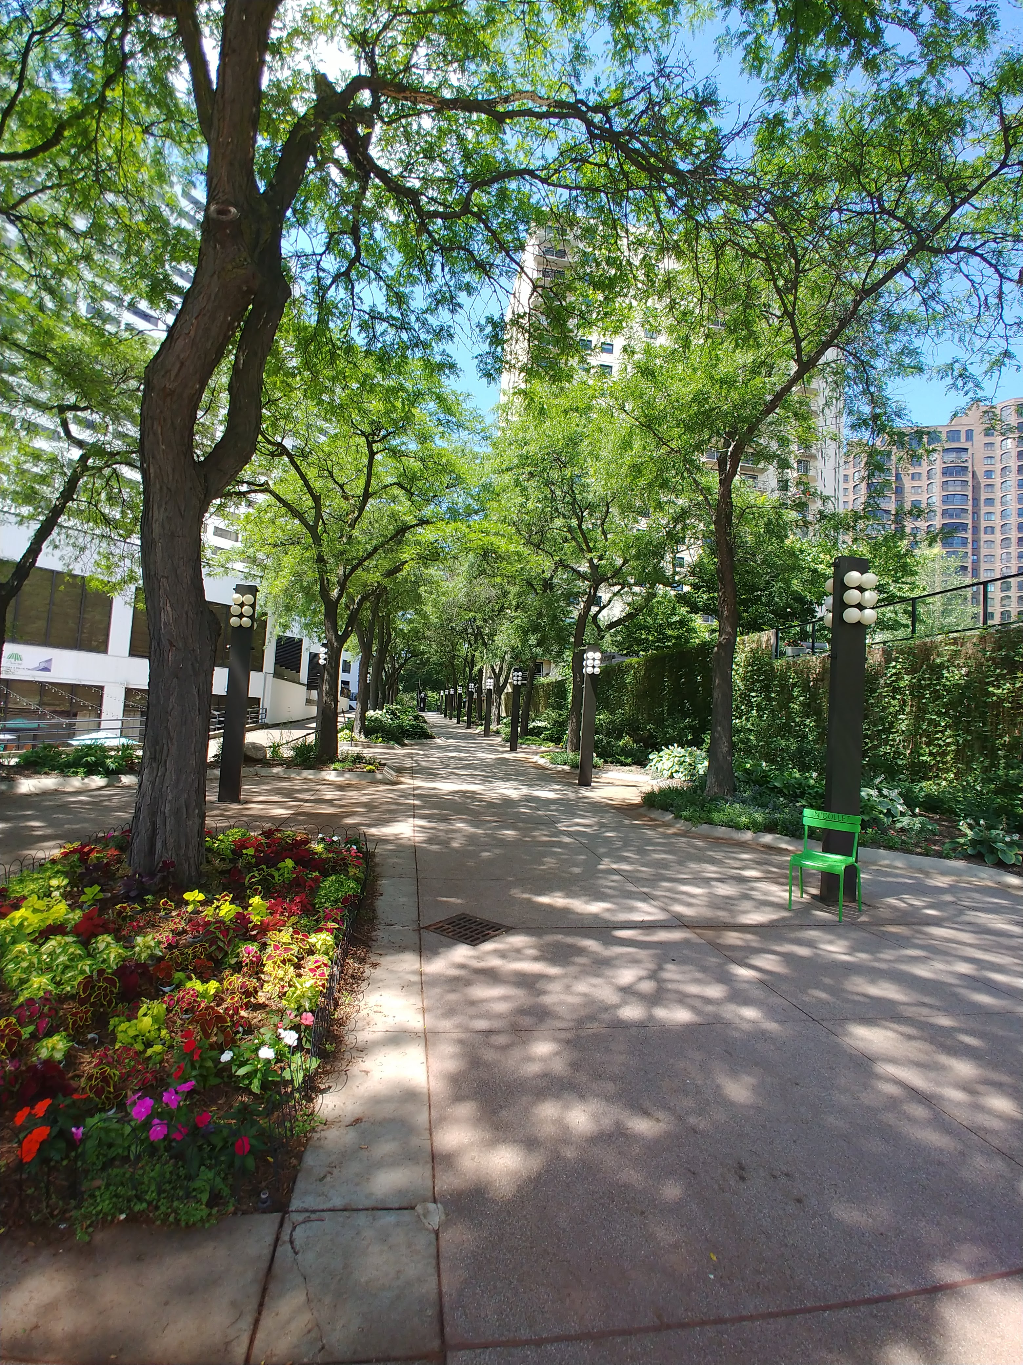
Examining Potential Green Gentrification in Brooklyn Park, MN
Maisong Francis

Slide 2
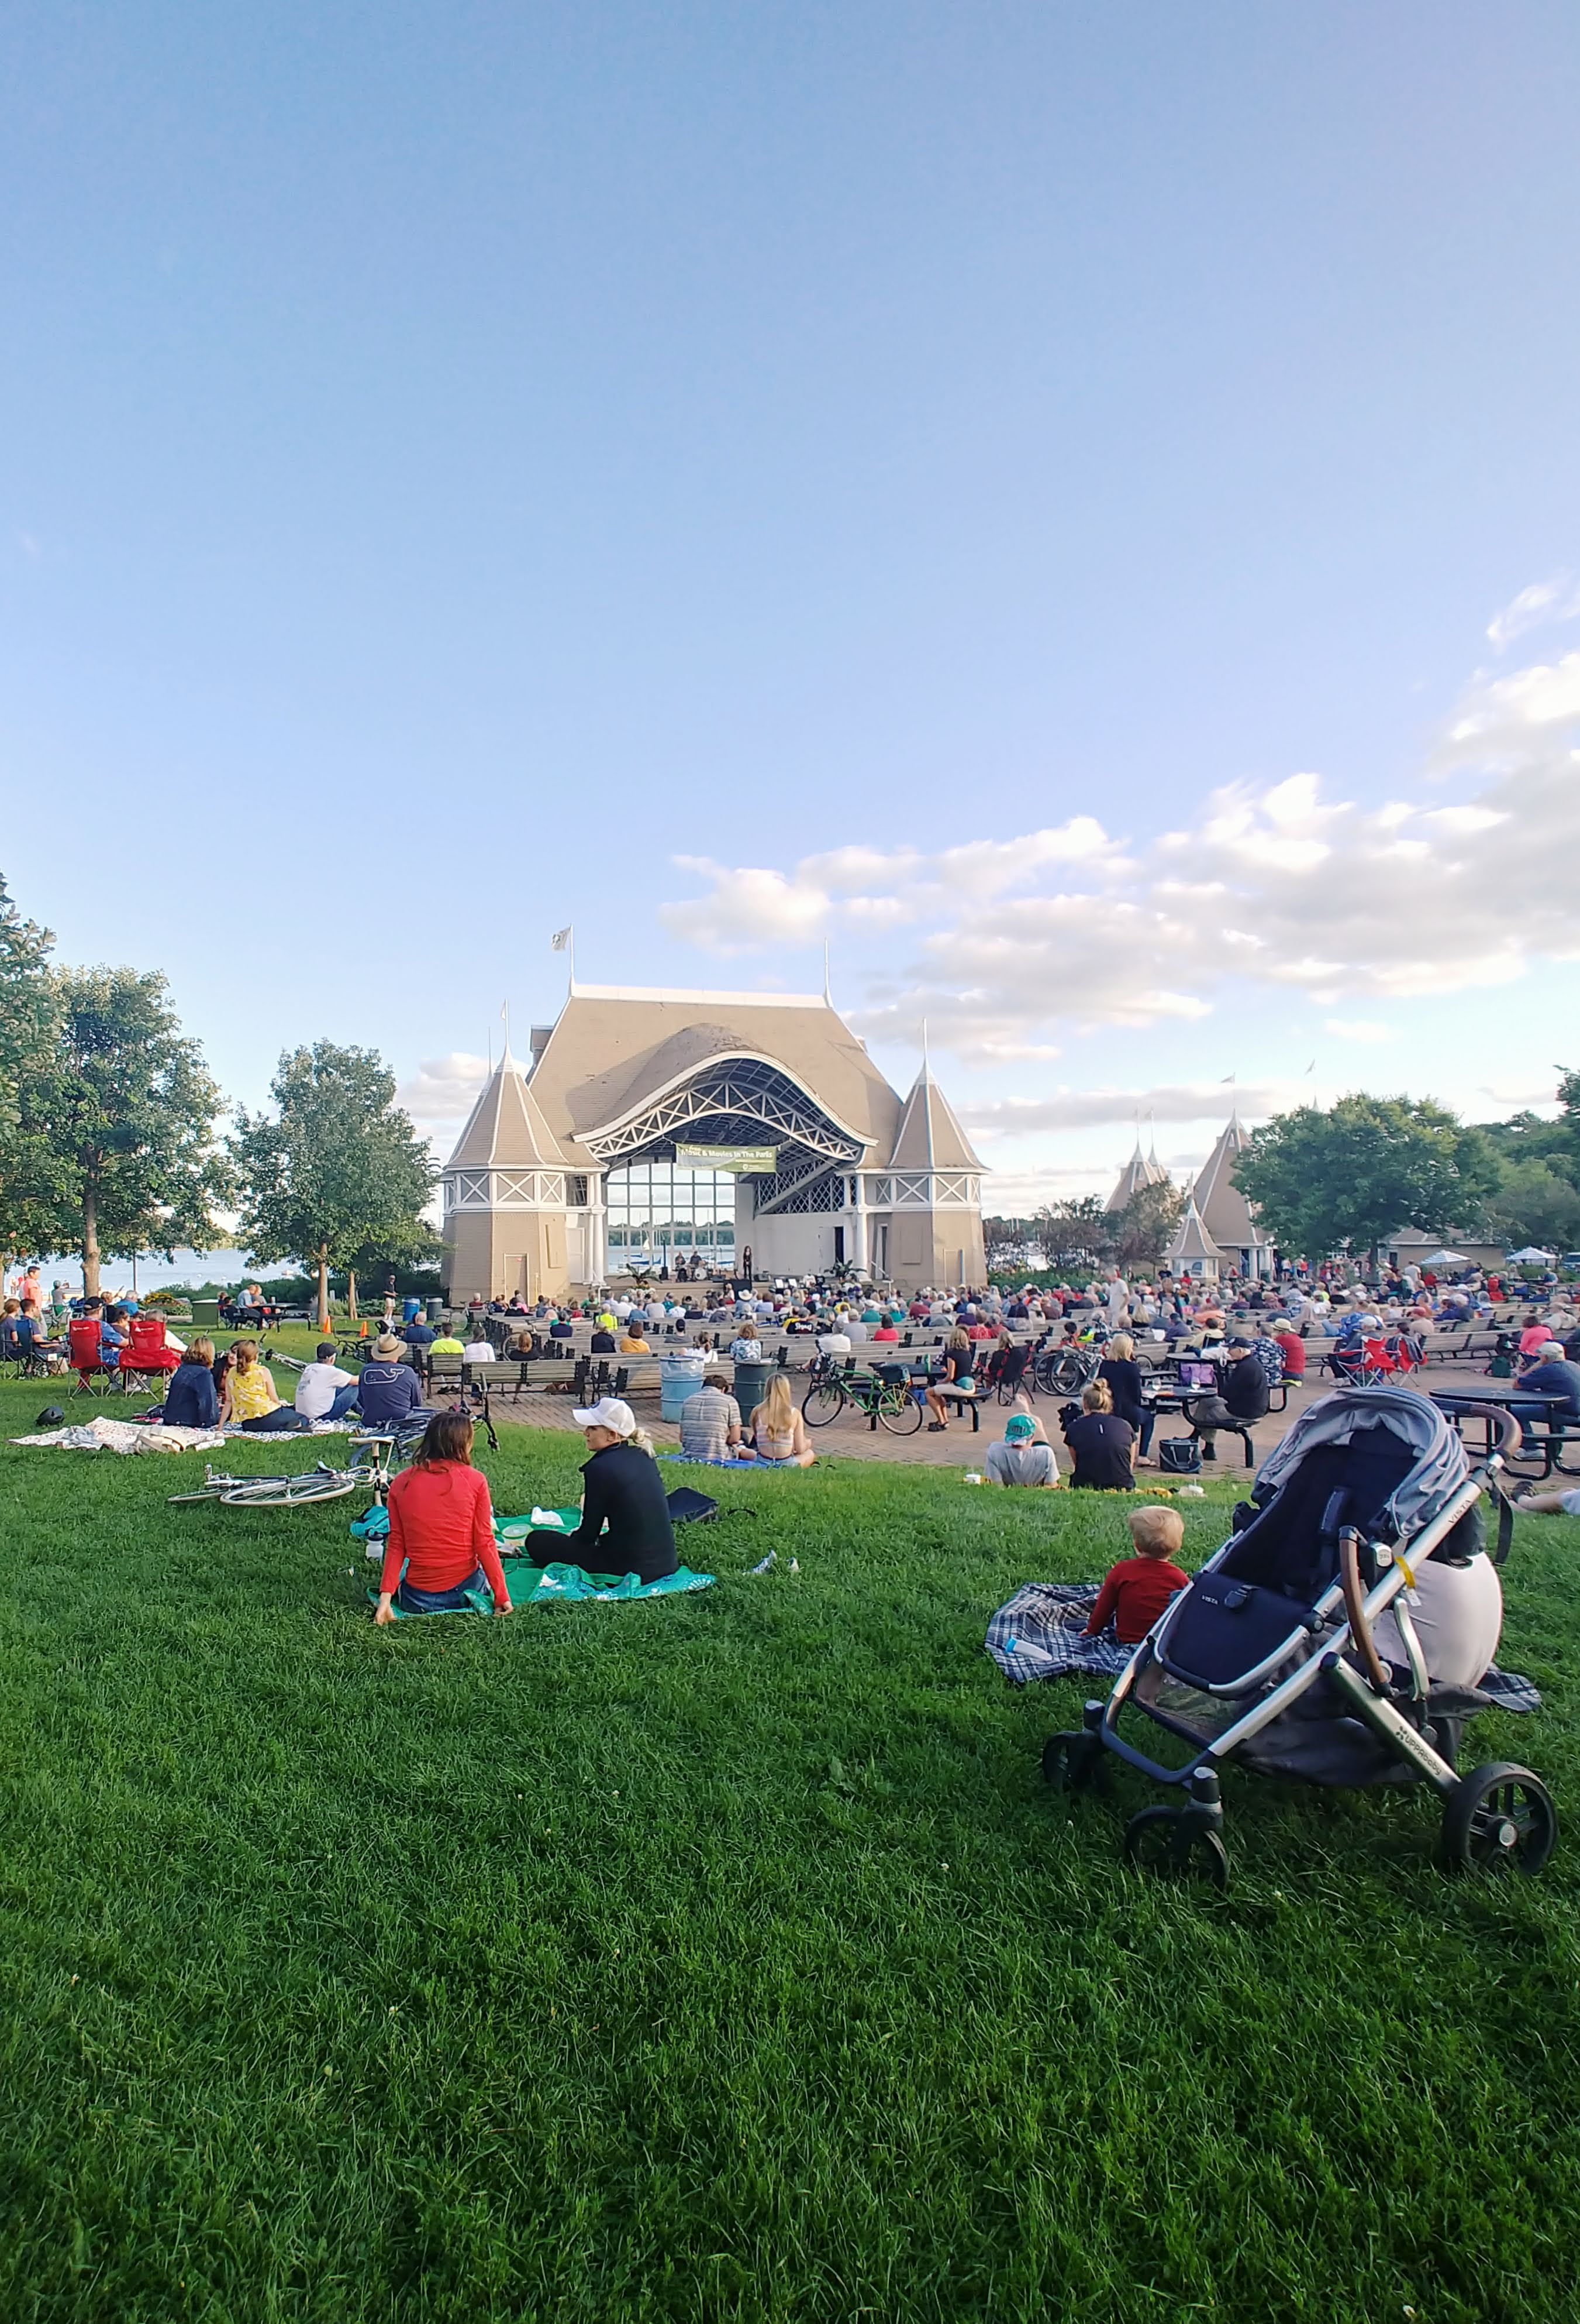
What is ‘Green Gentrification’?
Gentrification
When wealthier people take residency in an established neighborhood, causing housing values and rental prices to increase and changing the characteristics of the neighborhood.
Green Gentrification
Gentrification caused by development of green infrastructure
Notes:
Green gentrification is caused by the development of green infrastructure such as parks that attracts weathier people to an established neighborhood

Slide 3
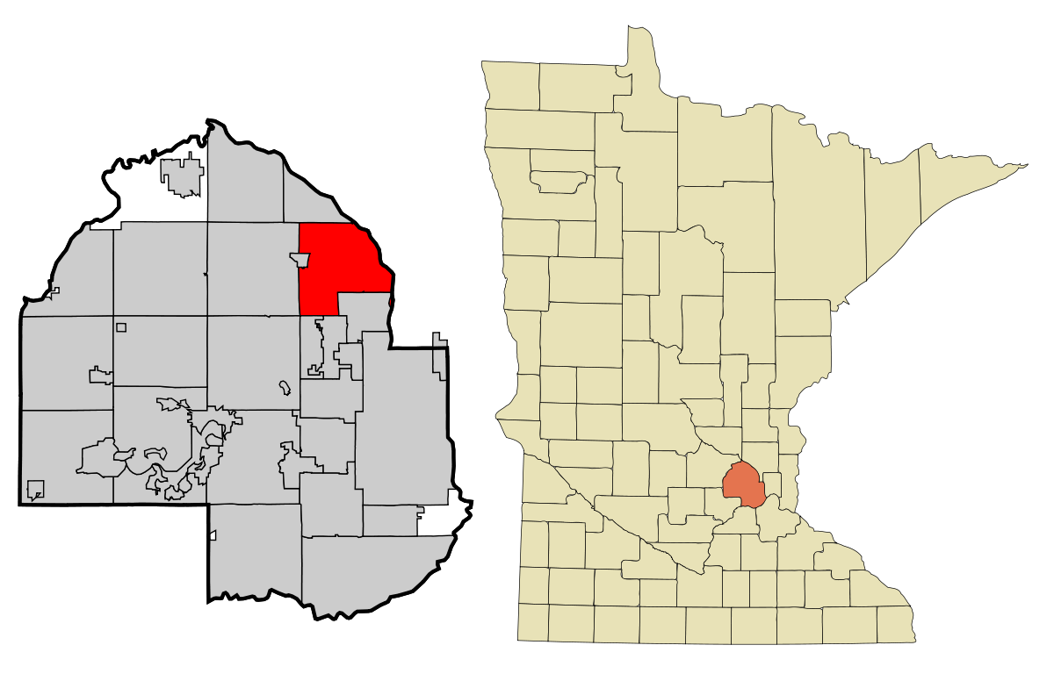
Study Area: Brooklyn Park, MN
Suburb of Minneapolis
Population: 80,000
At least 50% considered non-white
Green Space
At least 60 parks
91 Total block groups examined – some excluded if there were no data.
This Photo by Unknown Author is licensed under CC BY-SA

Slide 4
Objectives
Identify
Identify areas in Brooklyn park with high vulnerability to gentrification
Examine
Examine how parks affect housing value
Locate
Locate areas where green gentrification potentially occurred

Slide 5
Identify: Gentrification Vulnerability Index
 | SCORE
 | 1 | 2 | 3 | 4 | 5
Non-White | 0.00-0.142 | 0.143-0.284 | 0.285-0.426 | 0.427-0.568 | 0.569-0.71
Bachelor Degree Attainment | 0.305-0.382 | 0.229-0.304 | 0.153-0.228 | 0.077-0.152 | 0.00-0.076
Median Housing Income | $73,721-$86,037 | $61,405-$73720 | $49,089-$61,404 | $36,773-$49088 | $24,457-$36,772
Normalized percentages
Five equal intervals calculated for each variable
GVI = sum of scores for each variable.
Vulnerability Level | Low | Medium | High
GVI Score | 3-6 | 7-9 | 10-15
Block Group Count | 14 | 58 | 19
Notes:
Scores were assigned to ranges within each variable. Gentrification vulnerability index was calulcated by taking the sum of scores fore each block group.

Slide 6
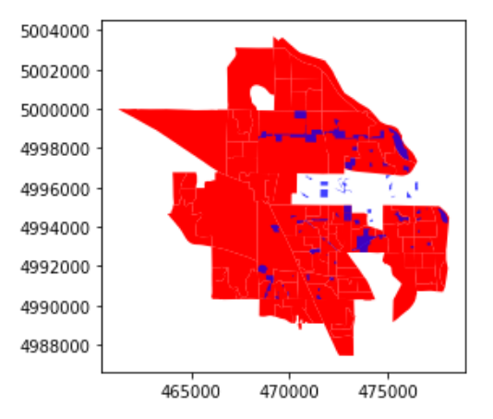
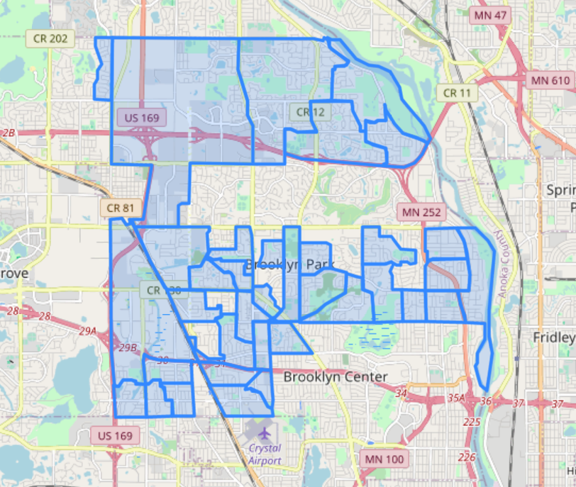
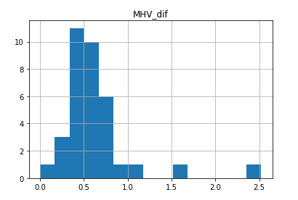
Examine: Park impacts on Median Housing Value
36 block groups are within 0.5 miles of a park

Slide 7
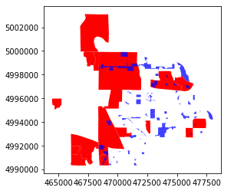
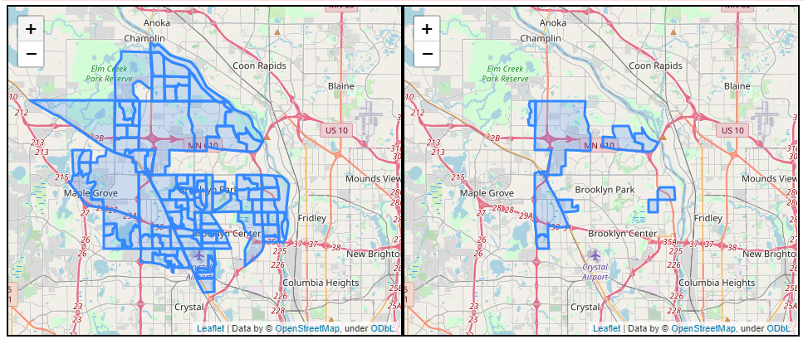
Locate: Potential Green Gentrification
Conditions:
GVI level = high
Be within 0.5 mile of a park
MHV change from 2000-2018 > 40%
Results: 9 potential block groups
Notes:
#

Slide 8

Lesson learned/Piece of Advice
Preprocessing data can take a lot of code
Relying on one module can be a mistake – especially if it decides to stop working
GVI is not accurate as some demographic variables have more weight than others.

